Slide 1
Comparative Evaluation of Space Mean Speed Estimation Methods Using Trajectory Data and Edie’s Definition
Prepared by: Saurav Barua

Slide 2
Work Plan
Location: Henri-Dunant Intersection
Methods:
Method 1: Entry-Exit travel time-based Space Mean Speed
Method 2: Instantaneous speed-based Space Mean Speed
Method 3: Trajectory based aggregation of Edie's Space Mean Speed
Method 4: Entry-Based aggregated Count Method for Space Mean Speed Estimation

Slide 3
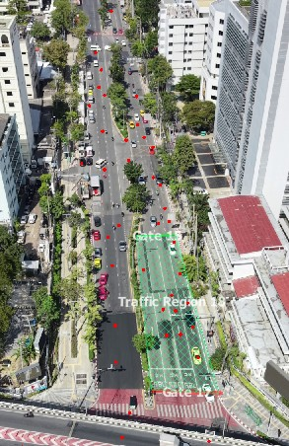
Screen shot from video showing entry and exit gate

Slide 4
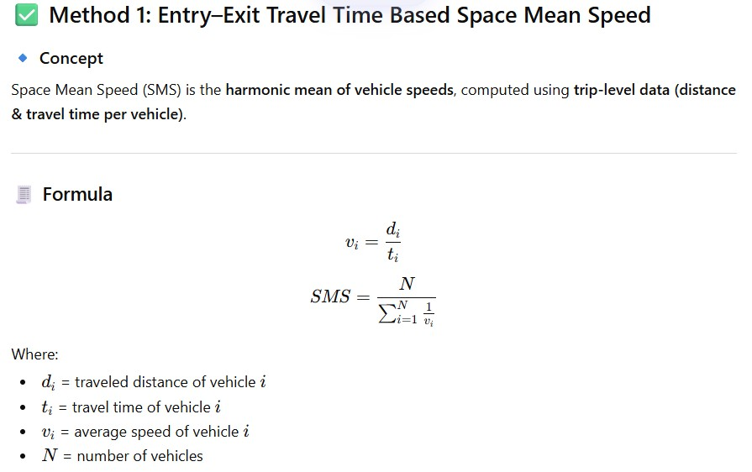
Method 1: Entry-Exit travel time-based Space Mean Speed
Pseudo Code:
INPUT: vehicle-level dataset (Entry Time, Exit Time, Distance) STEP 1: Remove duplicate rows → keep one row per vehicle STEP 2: For each vehicle i: travel_time[i] = Exit_Time[i] - Entry_Time[i] STEP 3: Remove vehicles where: travel_time[i] <= 0 STEP 4: Compute speed per vehicle: speed[i] = distance[i] / travel_time[i] STEP 5: Convert speed to km/h if needed: speed[i] = speed[i] * 3.6 STEP 6: Compute Space Mean Speed (harmonic mean): SMS = N / SUM(1 / speed[i]) OUTPUT: SMS

Slide 5
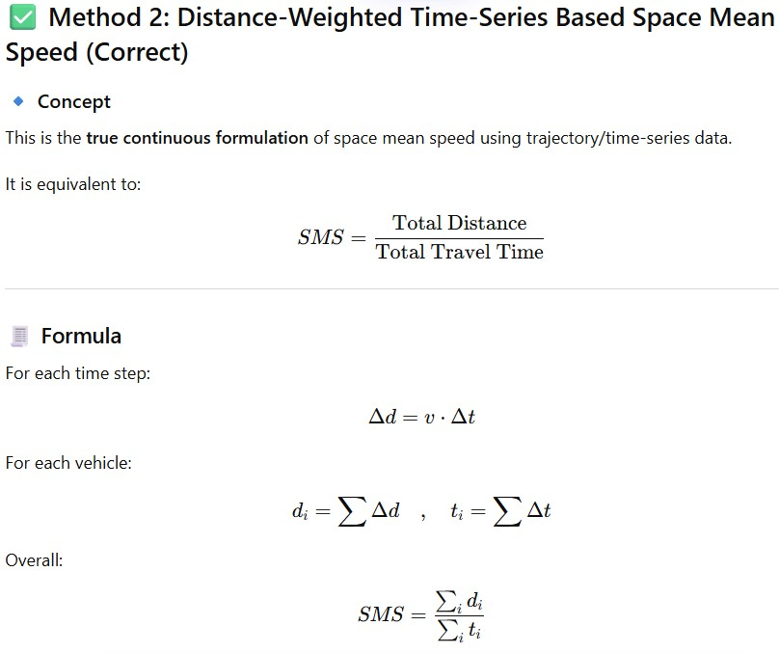
Method 2: Instantaneous speed-based Space Mean Speed
Pseudo Code
INPUT: trajectory dataset (Track ID, Time, Speed) STEP 1: Sort data by: Track ID, Time STEP 2: For each vehicle: Compute time difference: dt = current_time - previous_time STEP 3: Remove rows where: dt is NULL or dt <= 0 STEP 4: Convert speed: speed_mps = speed_kmh / 3.6 STEP 5: Compute step distance: step_distance = speed_mps * dt STEP 6: Aggregate per vehicle: total_distance[i] = SUM(step_distance) total_time[i] = SUM(dt) STEP 7: Compute per vehicle speed: speed[i] = total_distance[i] / total_time[i] STEP 8: Compute overall SMS: total_distance_all = SUM(total_distance[i]) total_time_all = SUM(total_time[i]) SMS = total_distance_all / total_time_all STEP 9: Convert to km/h: SMS = SMS * 3.6 OUTPUT: SMS

Slide 6
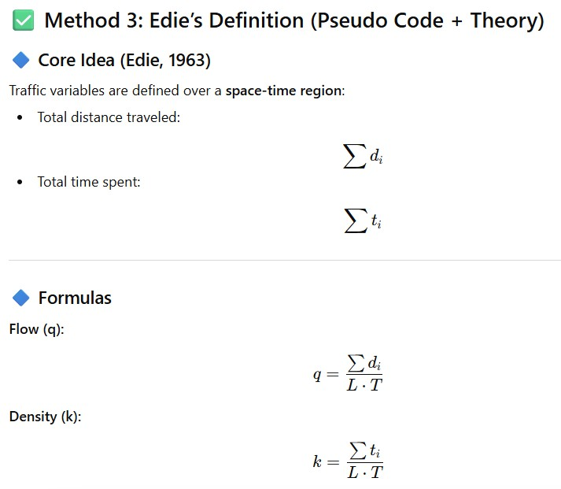
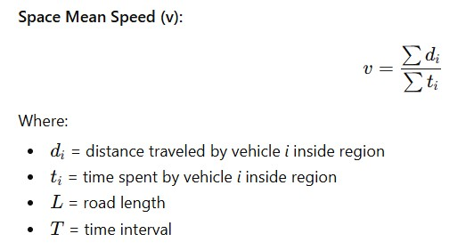
Method 3: Trajectory based aggregation of Edie's Space Mean Speed

Slide 7
Method 3: Trajectory based aggregation of Edie's Space Mean Speed (contd.)
Pseudo Code:
INPUT:
trajectory dataset with:
Track_ID, Time, step_distance
intervals = [1, 2, 5, 10, ...]
road_length = max(cumulative_distance) - min(cumulative_distance)
FOR each interval T in intervals:
STEP 1: Create time bins
For each row:
time_bin = floor(Time / T) * T
STEP 2: Initialize storage per time_bin
For each time_bin:
total_distance = 0
total_time = 0
STEP 3: Aggregate trajectory contributions
FOR each observation (row):
total_distance += step_distance
total_time += Δt
NOTE:
Δt = 1 second (since data is 1 Hz)
STEP 4: Compute Edie variables per time_bin
flow (q):
q = total_distance / (road_length * T)
density (k):
k = total_time / (road_length * T)
space_mean_speed (v):
v = total_distance / total_time
STEP 5: Unit conversion
v_kmh = v * 3.6
STEP 6: Store results per time_bin
END FOR
STEP 7: Compute summary over all time bins
avg_flow = mean(q)
avg_density = mean(k)
avg_speed = mean(v_kmh)
OUTPUT:
- Time-bin level results
- Interval summary results

Slide 8
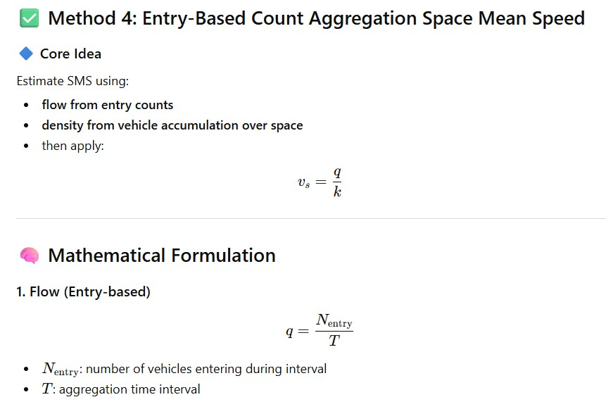
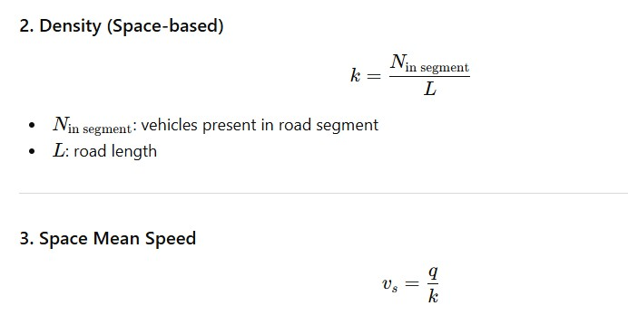
Method 4: Entry-Based aggregated Count Method for Space Mean Speed Estimation (contd.)

Slide 9
Method 4: Entry-Based aggregated Count Method for Space Mean Speed Estimation(contd.)
Pseudo Code:
INPUT:
trajectory data (Track ID, Time, position)
road_length L
list of aggregation intervals (e.g., 1s, 2s, 5s, 10s)
PREPROCESS:
Sort data by Track ID and Time
Define study segment [x_start, x_end]
FOR each aggregation interval T:
Divide time into windows:
[t0, t0+T], [t0+T, t0+2T], ...
FOR each time window W:
----------------------------
STEP 1: Compute Flow (q)
----------------------------
Count vehicles that ENTER segment during W:
N_entry = number of vehicles whose entry time ∈ W
Flow:
q = N_entry / T
----------------------------
STEP 2: Compute Density (k)
----------------------------
For each time instant t in W:
Count vehicles inside segment:
N(t) = number of vehicles with position in [x_start, x_end]
Average number of vehicles:
N_avg = (1 / T) * ∫ N(t) dt
≈ mean over sampled timestamps
Density:
k = N_avg / L
----------------------------
STEP 3: Compute SMS
----------------------------
IF k > 0:
v_s = q / k
ELSE:
v_s = NaN
----------------------------
STEP 4: Store Results
----------------------------
Save:
interval T
time window W
flow q
density k
space mean speed v_s
POSTPROCESS:
For each interval T:
Compute average SMS over all windows
OUTPUT:
Table:
interval | avg_flow | avg_density | avg_space_mean_speed

Slide 10
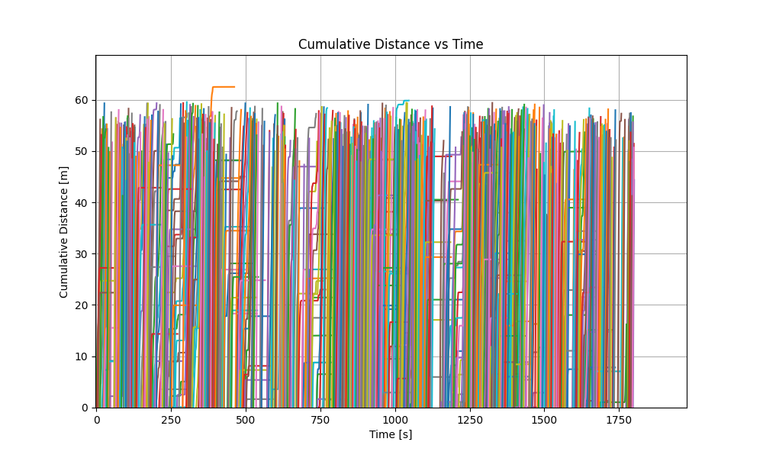
Trajectory plots

Slide 11
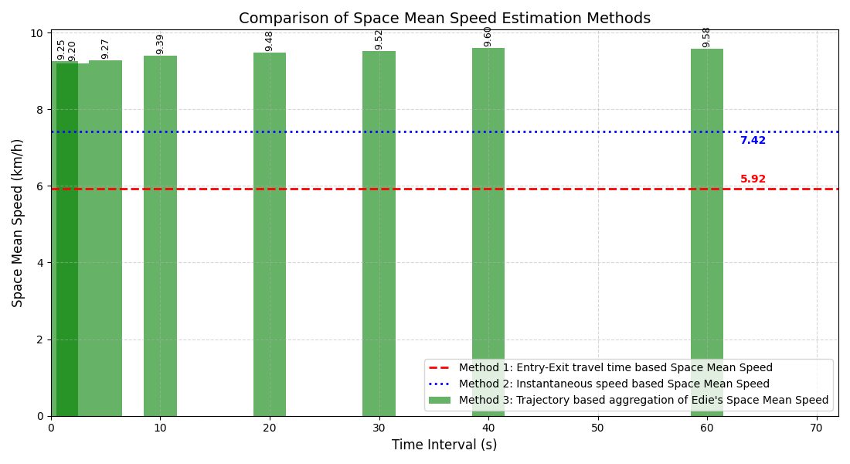
Comparison with Edie’s aggregation method

Slide 12
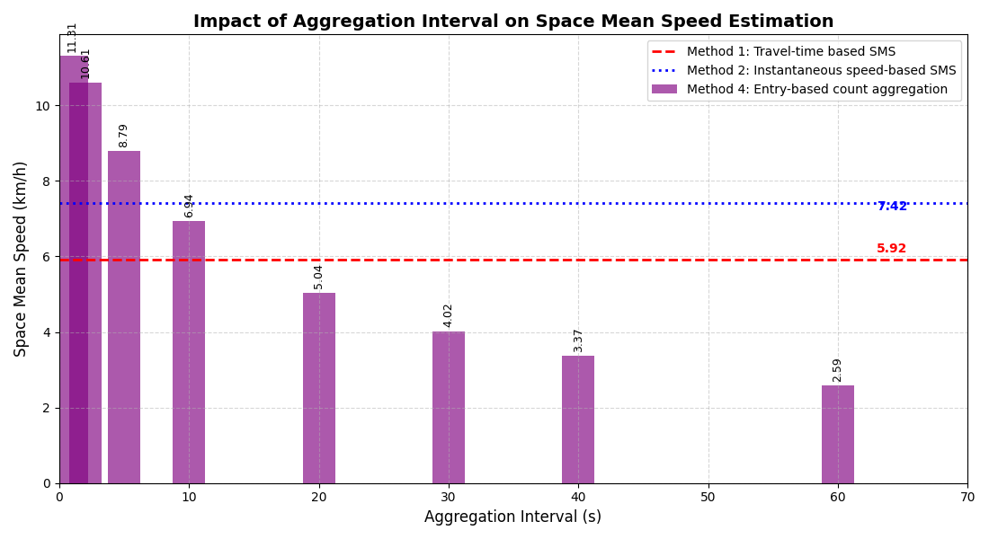
Comparison with entry-based count aggregation

